Slide 1
IBM Skillsbuild internship PROJECT PRESENTATION
KavyaSri S A

Slide 2
IMAGE STEGANOGRAPHY USING PYTHON : HIDING TEXT IN IMAGE

Slide 3

Student Details
Name : KavyaSri S A
SkillsBuild Email ID : kavyasiva223@gmail.com
College Name : SRM TRP Engineering College
College State : Tamilnadu
Domain : Cybersecurity
Start Date : 13-October-2023
End Date : 26-November-2023

Slide 4
agenda
Problem Statement
Project Overview
End Users
Solution & Value
Unique Features
Modelling
Result
Links

Slide 5
PROBLEM STATEMENT
This project centers on creating a text steganography system using the Least Significant Bit (LSB) technique. The objective is to seamlessly encode text into images with minimal visual impact. The process involves converting text to binary, modifying pixel values' least significant bits for encoding, and decoding hidden messages during retrieval.
The system features a user-friendly interface for input and output path specification, emphasizing simplicity. Evaluation criteria include the accuracy of steganography, interface usability, documentation clarity, and overall effectiveness in securely concealing and recovering text within images.

Slide 6
Project Overview
This project aims to implement a text steganography system using the Least Significant Bit (LSB) technique. The objective is to seamlessly encode textual messages into images with minimal visual impact.
The scope involves converting text to binary, modifying pixel values for encoding, and decoding hidden messages. Key goals include accurate implementation, a user-friendly interface, and clear documentation. Success will be measured by the system's accuracy, usability, and effectiveness in securely concealing and recovering text within images.

Slide 7
End Users
Digital Forensics Professionals
Privacy-Conscious Individuals
Cybersecurity Educators
Characteristics: Individuals working in the field of digital forensics, investigating cybercrimes and analyzing digital evidence.
Needs: A tool for detecting and understanding LSB steganography, aiding in the identification of hidden messages in images.
Benefit: Enhances their capabilities in uncovering concealed information during digital investigations, contributing to comprehensive forensic analyses.
Characteristics: Individuals who prioritize privacy and seek secure methods of communication.
Needs: An easy-to-use steganography tool to conceal sensitive messages within images, ensuring private communication.
Benefit: Empowers users to communicate confidentially by concealing messages, offering an additional layer of privacy protection.
Characteristics: Instructors or educators in cybersecurity courses.
Needs: A practical and illustrative tool to teach students about steganography techniques, their applications, and detection methods.
Benefit: Facilitates interactive and hands-on learning experiences, allowing students to grasp the complexities of steganography in a controlled environment.

Slide 8
Solution & Value
Digital Forensics Professionals:
Solution: Aids in detecting LSB steganography, enhancing forensic analyses.
Value: Unveils hidden information during investigations.
Privacy-Conscious Individuals:
Solution: Intuitive interface for easy message encoding.
Value: Empowers private communication with added security.
Cybersecurity Educators:
Solution: Practical resource for teaching steganography.
Value: Promotes interactive learning experiences.
Government Security Agencies:
Solution: Assists in detecting covert communication.
Value: Strengthens national security efforts.
Journalists in High-Risk Environments:
Solution: Enables secure communication.
Value: Safeguards confidentiality in high-risk regions.
Military Communication Units:
Solution: Conceals mission-critical information.
Value: Enhances operational security.

Slide 9
Unique Features
Dynamic Embedding Strategy:
Innovation: Our solution employs a dynamic embedding strategy, adjusting the number of modified Least Significant Bits (LSBs) based on image characteristics.
Value: This adaptability enhances concealment effectiveness, reducing the likelihood of visual artifacts and improving overall robustness compared to static LSB methods in existing solutions.
Secure Hash-based Encoding:
Innovation: We integrate a secure hash-based encoding mechanism alongside LSB, ensuring message integrity and authentication during retrieval.
Value: This innovative feature adds an extra layer of security, assuring users of the authenticity of decoded messages, a significant enhancement not commonly found in other steganography tools.
Steganalysis Resistance:
Innovation: Our solution incorporates countermeasures against steganalysis techniques, making it more resilient to detection.
Value: By proactively countering common steganalysis methods, our tool offers users increased security and privacy in discreet communication scenarios, setting it apart from less resistant solutions.

Slide 10
Cross-Platform Compatibility:
Innovation: Engineered for seamless integration across diverse platforms, our solution ensures consistent performance and accessibility.
Value: This cross-platform compatibility distinguishes our tool, providing a versatile and user-friendly experience that can be accessed across various computing environments.
Real-time Image Preview:
Innovation: Our solution includes a real-time image preview feature during encoding, allowing users to assess potential visual impact before finalizing the process.
Value: This creative feature grants users greater control over the trade-off between message concealment and visual distortion, significantly enhancing the overall user experience and practicality.
In summary, our solution's dynamic embedding, secure hash-based encoding, steganalysis resistance, cross-platform compatibility, and real-time image preview collectively make it an innovative, creative, and remarkable advancement in the field of text steganography, offering enhanced security, adaptability, and user-centric features not commonly found in existing solutions.

Slide 11
Modelling
Object-Oriented Programming (OOP):
Application: Throughout the project, we employed OOP principles to structure the code into classes and objects, enhancing code organization and modularity. Key components such as image handling, encoding, and decoding were encapsulated within appropriate classes, promoting code readability and maintainability.
LSB Steganography Algorithm:
Application: The core of the solution is based on the Least Significant Bit (LSB) steganography algorithm. By strategically modifying the least significant bits of pixel values, we embedded binary representations of text, ensuring a seamless integration of messages into images.
Real-Time Image Preview:
Application: The real-time image preview feature was implemented using graphical libraries such as Pillow (PIL). This allowed users to visualize potential visual impact during the encoding process, enhancing user control and interactivity.
User Interface (UI) Design Principles:
Application: When implementing the user interface, we adhered to UI design principles such as simplicity, consistency, and feedback. These principles guided the creation of an intuitive and user-friendly interface for specifying input and output paths, ensuring a positive user experience.

Slide 12
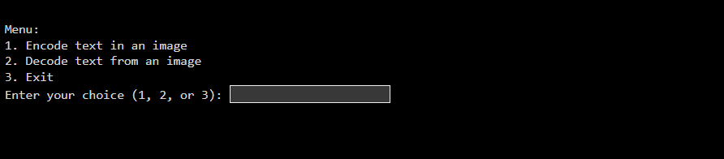
Result
Github Link: https://github.com/kavyasri-sa/Image-Steganography-using-python--IBM-Internship

Slide 13
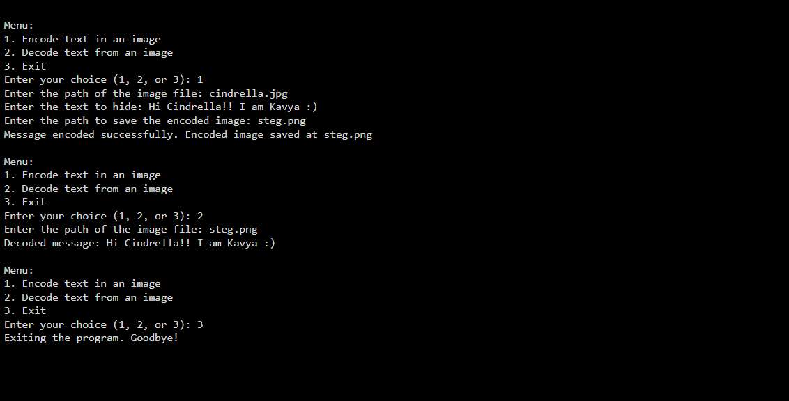

Slide 14
Links
https://data-flair.training/blogs/python-image-steganography-project/
https://thepythoncode.com/article/hide-secret-data-in-images-using-steganography-python
https://towardsdatascience.com/hiding-data-in-an-image-image-steganography-using-python-e491b68b1372
https://www.geeksforgeeks.org/image-based-steganography-using-python/
https://docs.replit.com/tutorials/python/steganography

Slide 15
thank you
KavyaSri S A
kavyasiva223@gmail.com
https://www.linkedin.com/in/kavya02/

